Slide 1
CharArrayWriter
CharArrayWriter uses an char-array as the destination.
The buffer[i.e. char-array] automatically grows when data is written to the stream. The data can be retrieved using toCharArray() and toString().
Invoking close() on CharArrayWriter has no effect. When you are finished writing characters to a Java CharArrayWriter you can close. Since the CharArrayWriter is not connected to any underlying system resources, like files or network connections, it is not crucial to close it.
The Java CharArrayWriter class (java.io.CharArrayWriter) makes it possible to write characters via the Writer methods (CharArrayWriter is a subclass of Writer) and convert the written characters into a char-array.
The Java CharArrayWriter class is handy when you have a component that can only write characters to a Writer, but you need the characters as a char-array. Simply pass that component a CharArrayWriter and when all characters are written to it, call toCharArray() on the CharArrayWriter.
CharArrayWriter
Java Application
Write
Write
Char Array

Slide 2
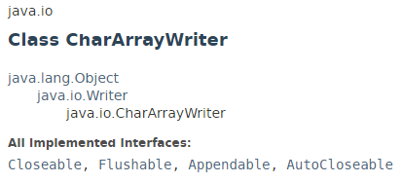
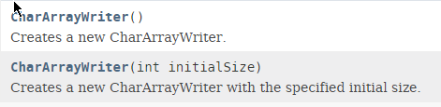
CharArrayWriter

Slide 3
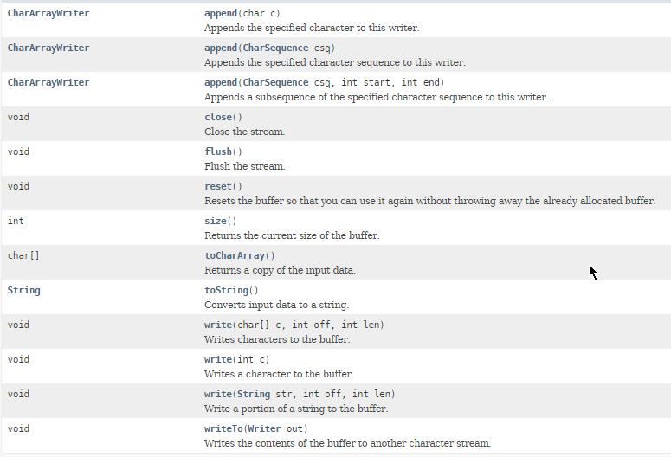
CharArrayWriter

Slide 4
CharArrayWriter
https://docs.oracle.com/javase/8/docs/api/index.html?java/io/CharArrayWriter.html

